Slide 1
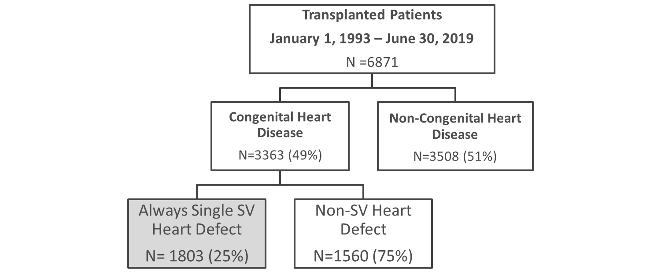
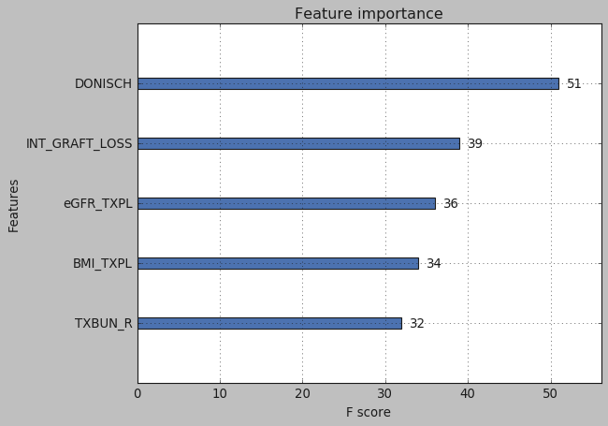
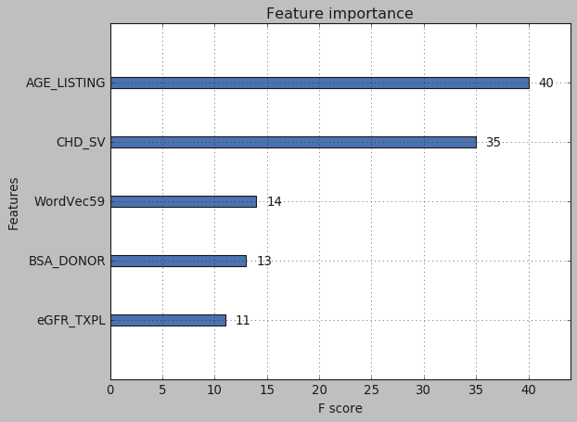
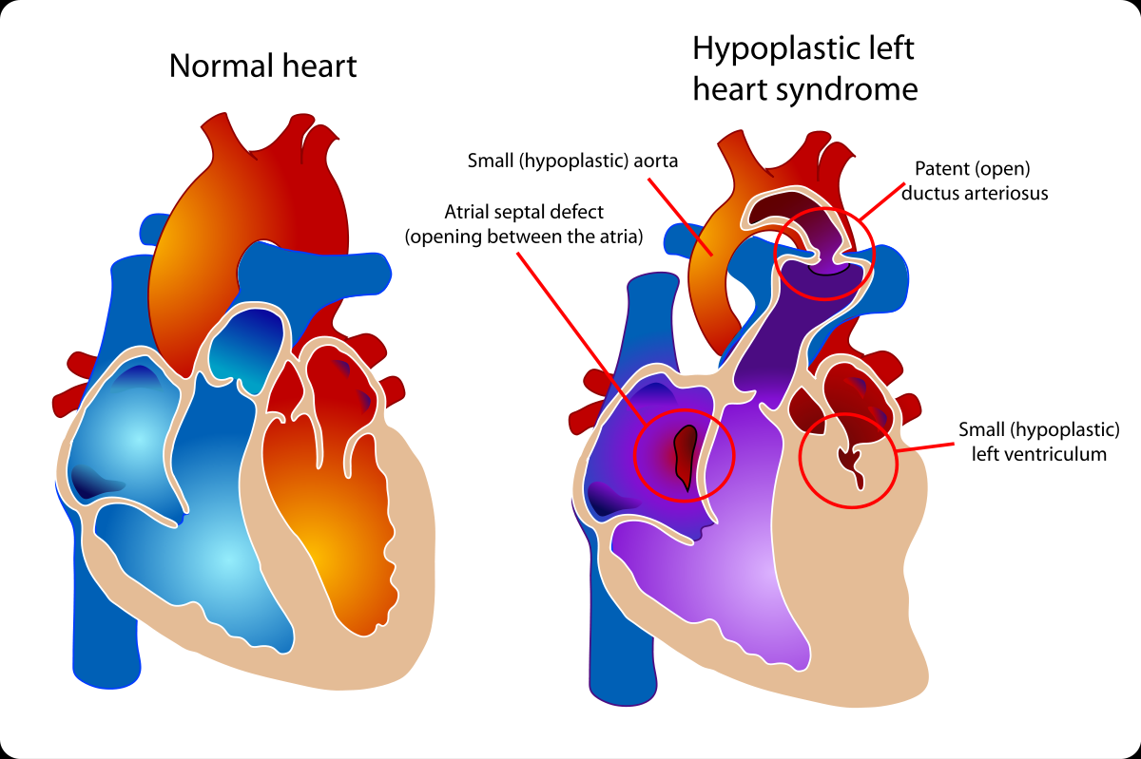
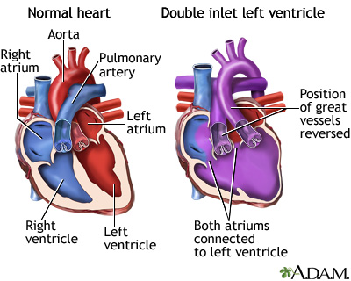
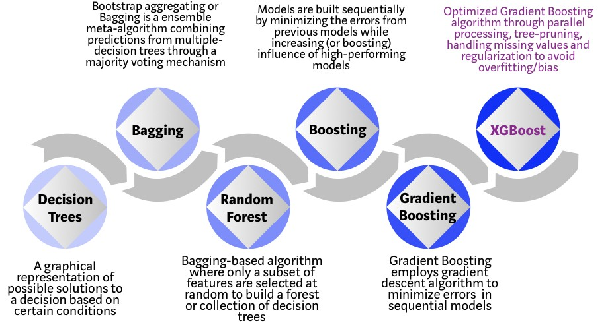
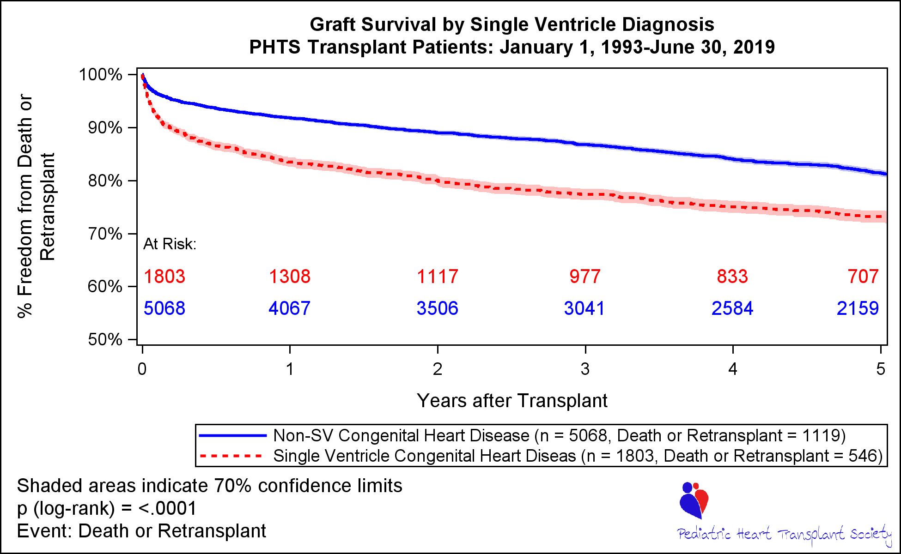
Prediction of Single Ventricle Congenital Heart Disease from Free Text Tobias O’Leary, Devin Koehl The University of Alabama at Birmingham
Pediatric Heart Transplant Society
Cohort Identification
Bio2Vec
Results
The Pediatric Heart Transplant Society (PHTS) was established in 1993 by a group of physicians who wanted to improve the lives of children who needed a heart transplant.
The PHTS registry is a national longitudinal observational study enrolling children when they are listed for a heart transplant.
Patients are followed in the registry while on the waitlist and after transplantation
PHTS has 56 participating centers and over 9000 listed patients
Bio2Vec is a platform that enables the development of machine learning and data analytics methods to be applied on biological Big Data, with the aim of discovering molecular mechanisms underlying complex disease and drugs’ mode of action.
It covers embeddings from text and knowledge graphs such as GO terms, proteins, drugs, diseases, proteins and protein interactions.
ML Model | F1 | AUC
All Features | 0.741 | 0.650
All Featuers + Text Fields | 0.863 | 0.830
Only Text | 0.834 | 0.741
All PHTS Features
All Features + Bio2vec Embeddings
XG Boost
.XGBoost is a decision-tree-based ensemble Machine Learning algorithm that uses a gradient boosting framework. When it comes to small-to-medium structured/tabular data, decision tree based algorithms are considered best-in-class right now.
Single Ventricle Heart Disease
Always Single Ventricle Congenital Heart Disease Includes
Hypoplastic Left Heart
Tricuspid Atresia
Double Inlet Left Ventricle
Importance provides a score that indicates how useful or valuable each feature was in the construction of the boosted decision trees within the model. The more an attribute is used to make key decisions with decision trees, the higher its relative importance.
Single Ventricle Prediction
A single ventricle defect is a type of heart defect that a child is born with. It occurs when one of the two pumping chambers in the heart, called ventricles, isn’t large enough or strong enough to work correctly. In some cases, the chamber might be missing a valve.
Single ventricle defects are rare, affecting only about five out of 100,000 newborns. They are also one of the most complex heart problems, usually requiring at least one surgery.
Utilizing Patients flagged from our free text fields, SV Status was predicted in our total transplanted patient population (n=6871)
Physicians must manually review text fields to identify if a patient is SV or Non-SV. Can we train a model to make this prediction?
Patients that are single ventricle are of very high clinical interest as their risk for death or retransplant is greater as seen in the Kaplan-Meier, p<0.0001
Conclusions
Free text fields provide valuable information that can often be overlooked by medical personnel
Over 90 patients were added to the cohort from examination of free text fields alone
These text fields along with other clinical factors can help predict single ventricle status with an accuracy over close to 90%
Text fields alone also provide value to predict single ventricle status with accuracy reaching 85%
Machine Learning Models
80% of the data was used for training and 20% was used for testing
Features with >25% missing were excluded from the model. Missing values were imputed with the median. Over 100 clinical features were utilized.
Logistic Regression, SVM, Decision Trees, and XGBoost were all used to analyze 3 separate machine learnings models:
All binary and continuous features in PHTS
All Features + Text Fields
Only Text fields
Text Fields Included Surgery History, CHD Specify, and Medical History at Listing
XGBoost performed the best out of all models, with accuracy close to 90% and an AUC of 0.8.
Materials & Methods
Pediatric Heart Transplant Study Database was used to identify Single Ventricle (SV) Heart Disease
Donor, transplant and recipient information for these patients was collected
p-value of <0.05 is considered statistically significant and Survival was compared using SAS 9.4. Machine Learning was complete using Python 3.5.2
Text fields were utilized for modeling purposes
WordCloud representing all keywords in the Other Specify Fields
Natural Language Processing: CS 662

